Slide 1
Video Game Case Study
By Richard Pountney

Slide 2
Overview of the Presentation
The genre(s) I have chosen to focus on is the Roguelike & Roguelite
The Game I will focus on will be shown on slide 9
Images used will have references either with them or at the end of the presentation.

Slide 3
The origin of these Genres
The genres “roguelike” and “roguelite” were spawned from the mechanics established in the game “Rogue” which was released in 1980.
The game “Rogue” was made with the concept of permadeath & procedurally generated dungeons. This meant that nothing carried over from your previous run & that every run was different. This forced the players to explore a new map & adapt to new circumstances.
“roguelite” used to be “roguelike-like”

Slide 4
The Key Difference Between Roguelikes & Roguelites
The biggest key difference is that Roguelites have meta-progression whereas Roguelikes Do Not.
You can discuss this in your own time.

Slide 5
Core Mechanics of These Genres
Randomised generation of levels
Randomised equipment generation
Permadeath
Battle/fighting
Game progression
Difficulty curves

Slide 6
Core Mechanics that are Different Between These Genres
Roguelike
No meta-progression
All equipment is obtainable without needing to unlock them in a run.
No different characters &or characters have no difference in mechanics.
Roguelite
Has meta-progression
Has equipment that needs to be unlocked before being able to obtain it normally.
Has different characters with different benefits.

Slide 7
Objective & Purpose
The objective is to complete a run
The purpose is to make the player have to learn the controls of the game, how each enemy behaves, how the equipment works & their synergy.
Having to start fresh each run makes it fun because it will not be the same each time this is thanks to the random generation of the game.
But in the case of roguelite you have fun with all the new stuff that you have unlocked as well as the randomness.

Slide 8
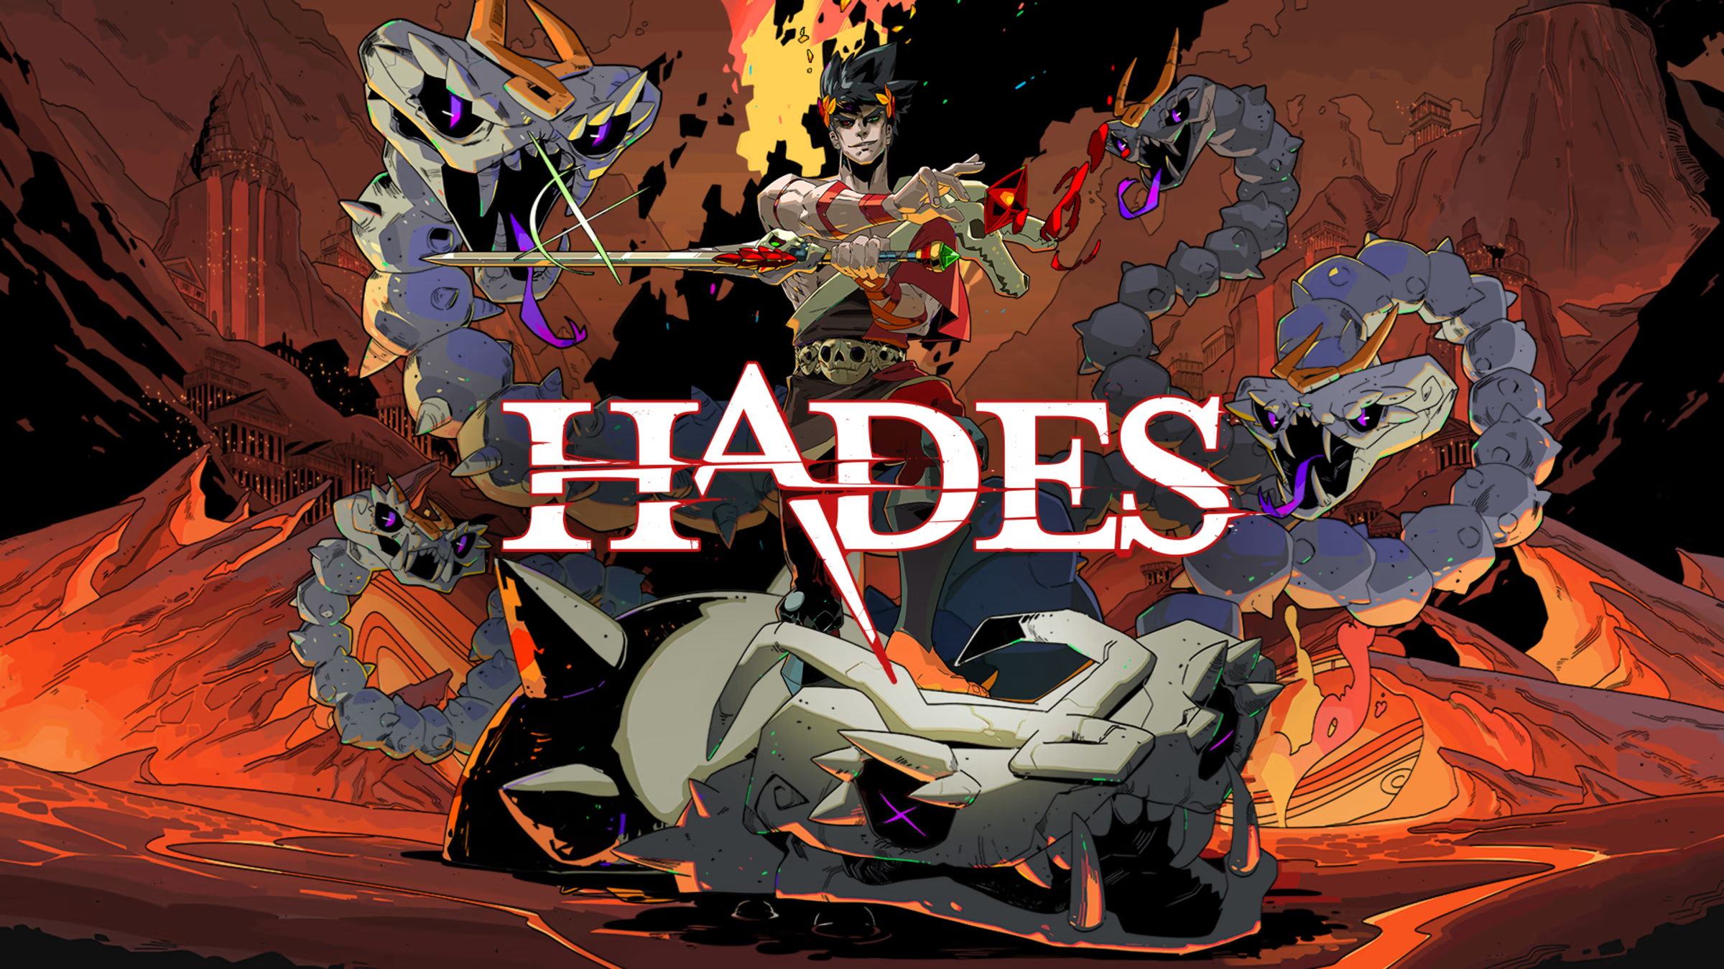
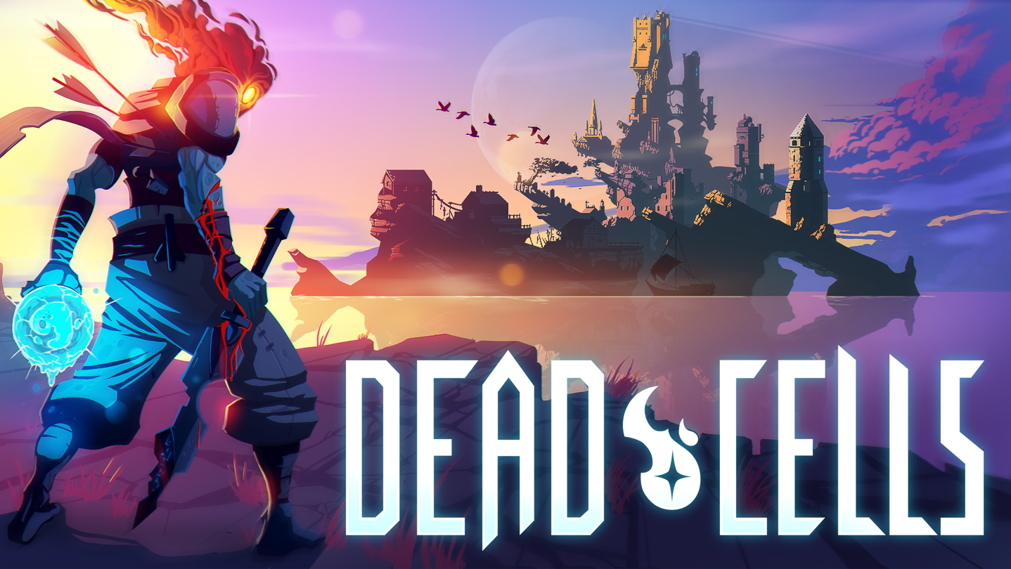
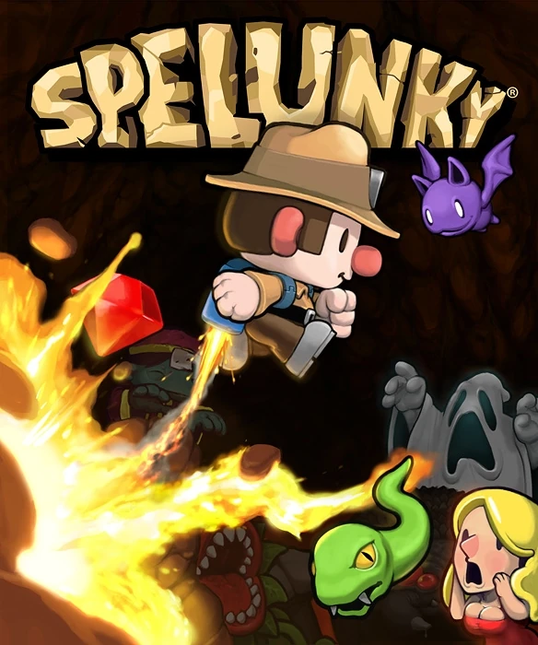

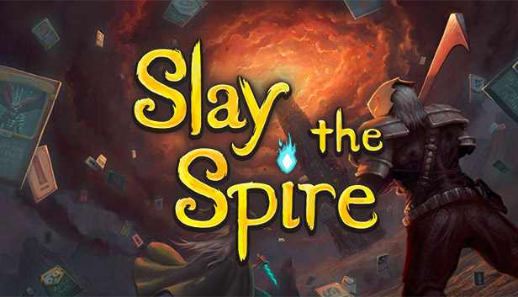
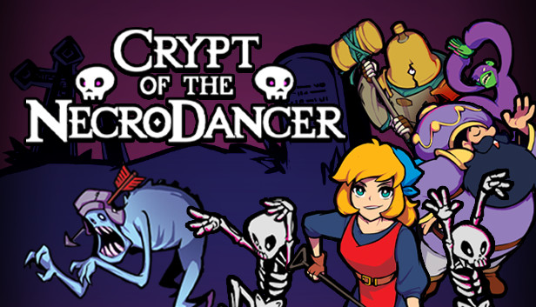
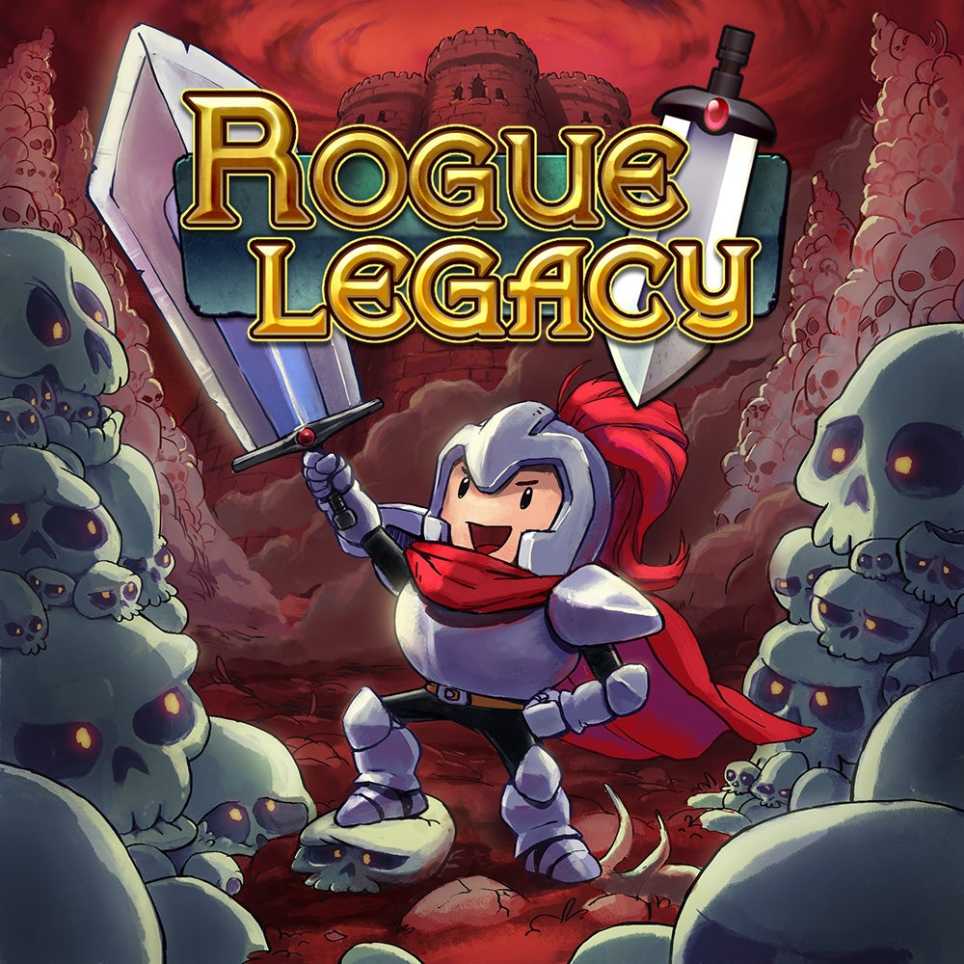
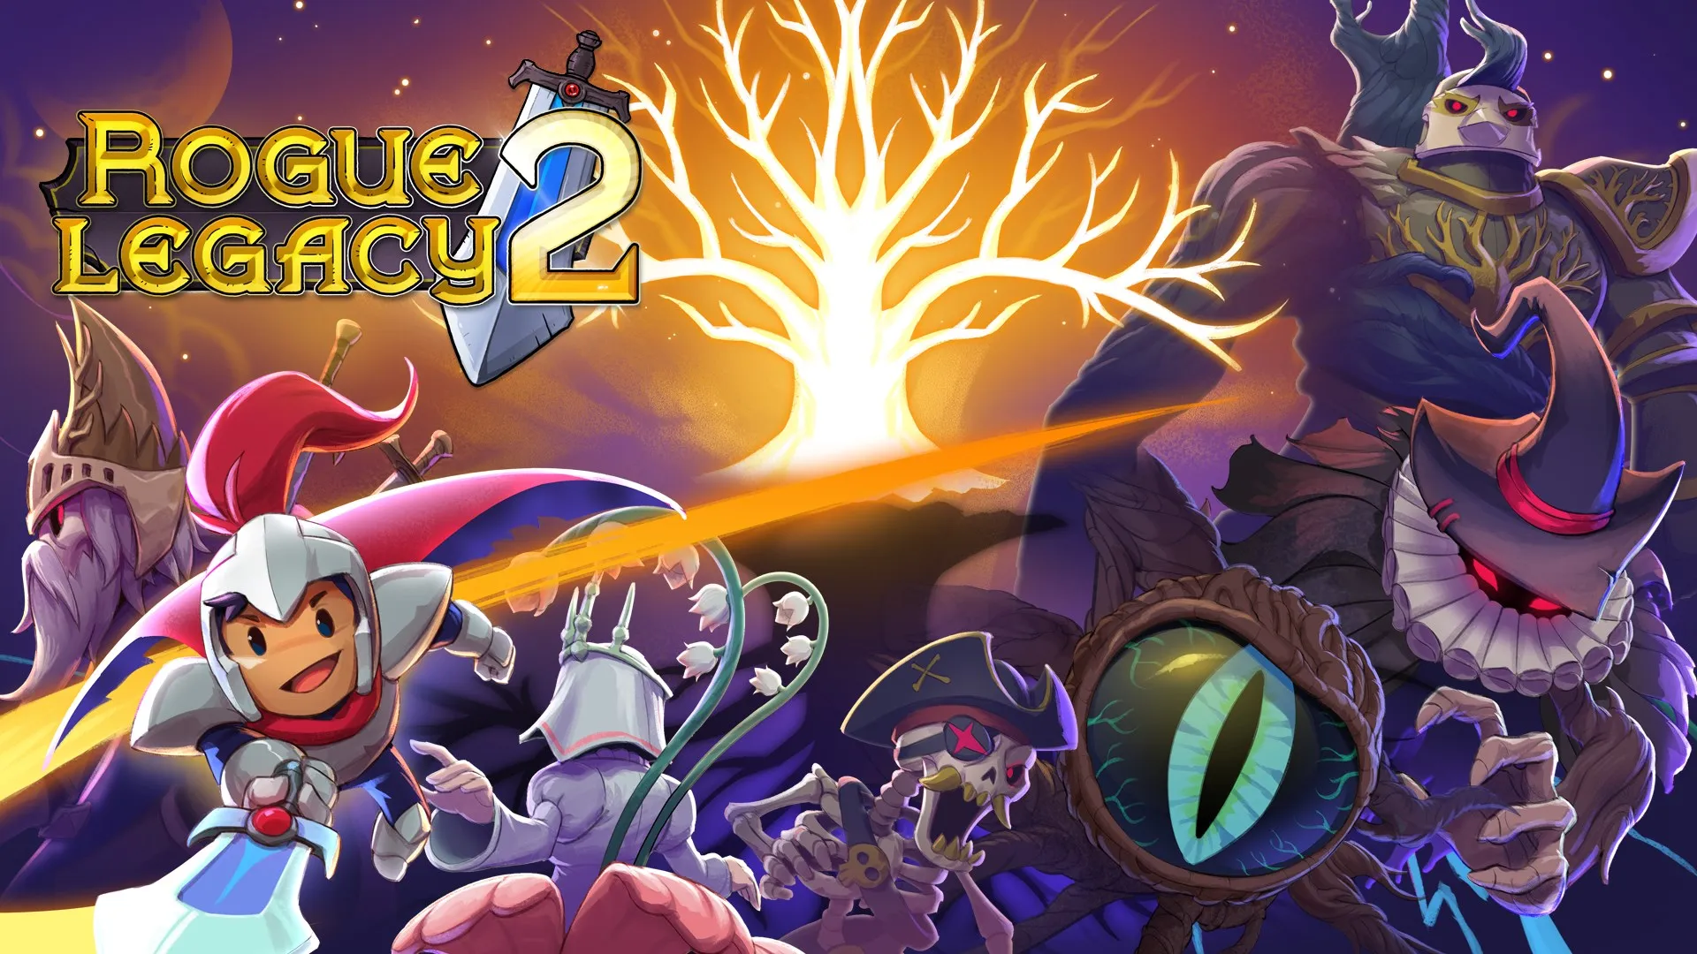
Some Games of These Genres

Slide 9
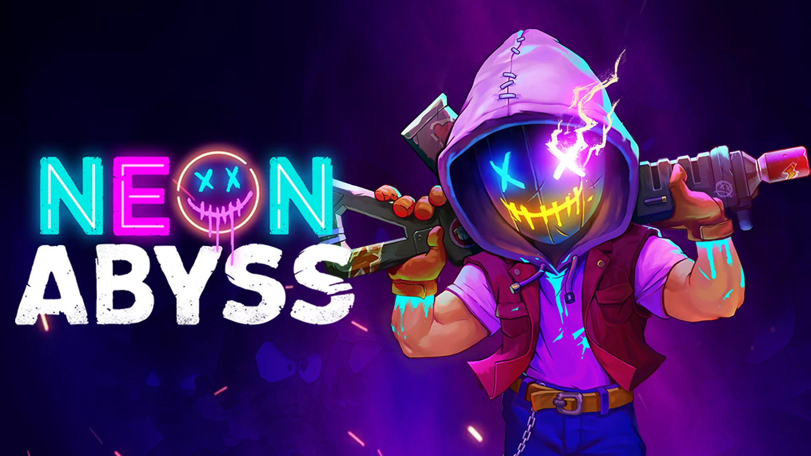
Chosen Game
The game I will focus on is “Neon Abyss”
https://www.team17.com/wp-content/uploads/2019/08/final-NA.png

Slide 10
Target Audience

Slide 11
Consumer Habits

Slide 12
Elements of Neon Abyss

Slide 13
References
For information (Slides 3 – 7):
Roguelike vs. Roguelite: What's the difference between the two? - Destructoid
The Difference Between Roguelite & Roguelike Games Explaned - GameRant
Roguelike Vs Roguelite: The Differences Explaned - SVG
Roguelike vs Roguelite | Do you know the difference? - G2A
Uh Oh, Everyone is Mixing Up Roguelikes & Roguelites Again - TheGamer
What is the difference between Roguelike & Roguelite? - Medium
Roguelike vs Roguelite - what's the difference? - Pocket Tactics

Slide 14
References
For images of games in the genres:
https://assets.nintendo.com/image/upload/c_fill,w_1200/q_auto:best/f_auto/dpr_2.0/ncom/en_US/games/switch/h/hades-switch/hero
https://dead-cells.com/img/screen_fb.jpg
https://static.wikia.nocookie.net/spelunky/images/a/a6/Spelunky-boxart.jpg/revision/latest?cb=20121108192844
https://static.wikia.nocookie.net/spelunky/images/d/df/Spelunky_2_Cover.jpg/revision/latest?cb=20210114071119
https://cdn.akamai.steamstatic.com/steam/apps/646570/capsule_616x353.jpg?t=1592339399
https://cdn.akamai.steamstatic.com/steam/apps/247080/capsule_616x353.jpg?t=1659637239
http://assets1.ignimgs.com/2019/04/09/rogue-legacy---button-fin-1554771200048.jpg
https://i0.wp.com/news.xbox.com/en-us/wp-content/uploads/sites/2/2022/04/Rogue-Legacy-2-b44b6750535d8b2d9cde.jpg?fit=1920%2C1080&ssl=1

Slide 15
References
Interpret consumer demographics (Slides 10 - 11)
Neon Abyss – Reviews – HowLongToBeat.com
Neon Abyss for PC Reviews – Metacritic
Neon Abyss for PlayStation Reviews – Metacritic
Neon Abyss for Xbox One Reviews – Metacritic
Neon Abyss for Switch Reviews – Metacritic
Neon Abyss – Review – Maxi-Geek
Neon Abyss System Requirements
Neon Abyss Reviews – OpenCritic
Statistics
Neon Abyss – PC
Neon Abyss – PlayStation
Neon Abyss – Xbox
Neon Abyss – Switch
Playtracker

